Slide 1


Expense Reimbursement and Progress Reporting
Prepared for:
Human Services Funding Recipients
January 23, 2025

Slide 2
Expense Reimbursement
Expense Reimbursement and Progress Reporting

Slide 3

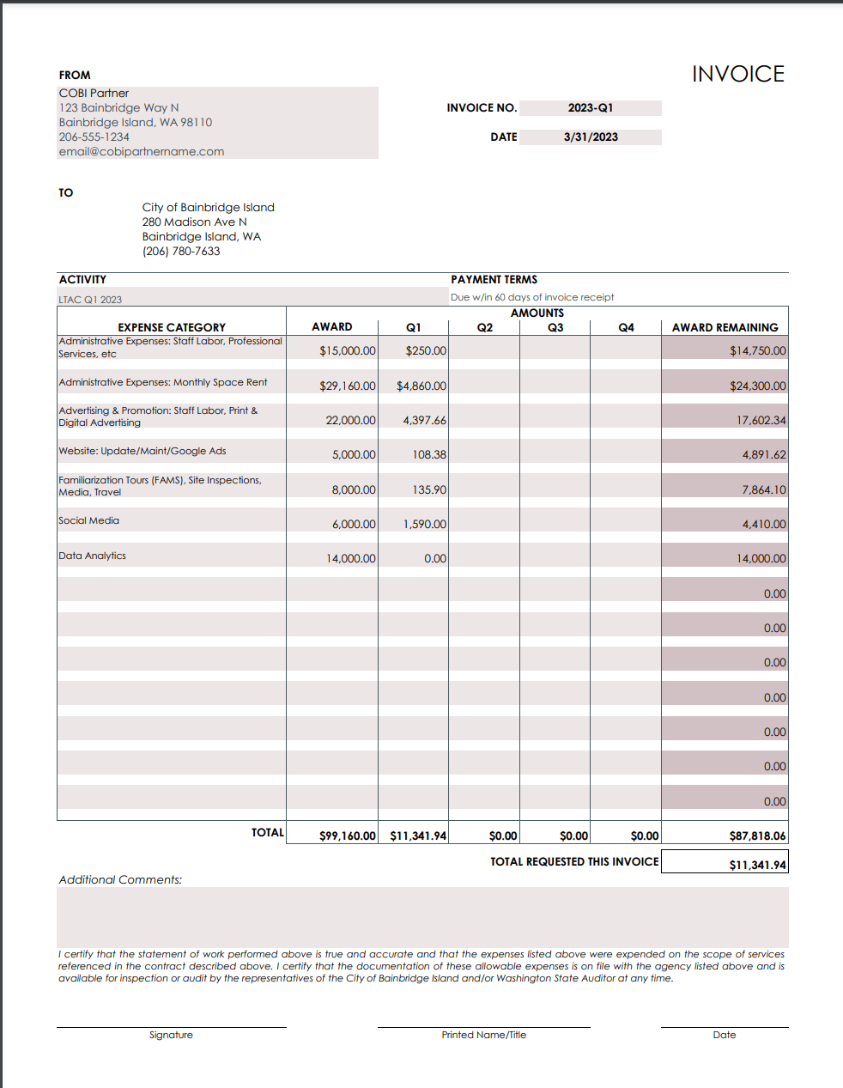
Expense Reimbursement
Page Title
Jan. 23, 2025
Expense Reimbursement and Progress Reporting

Slide 4
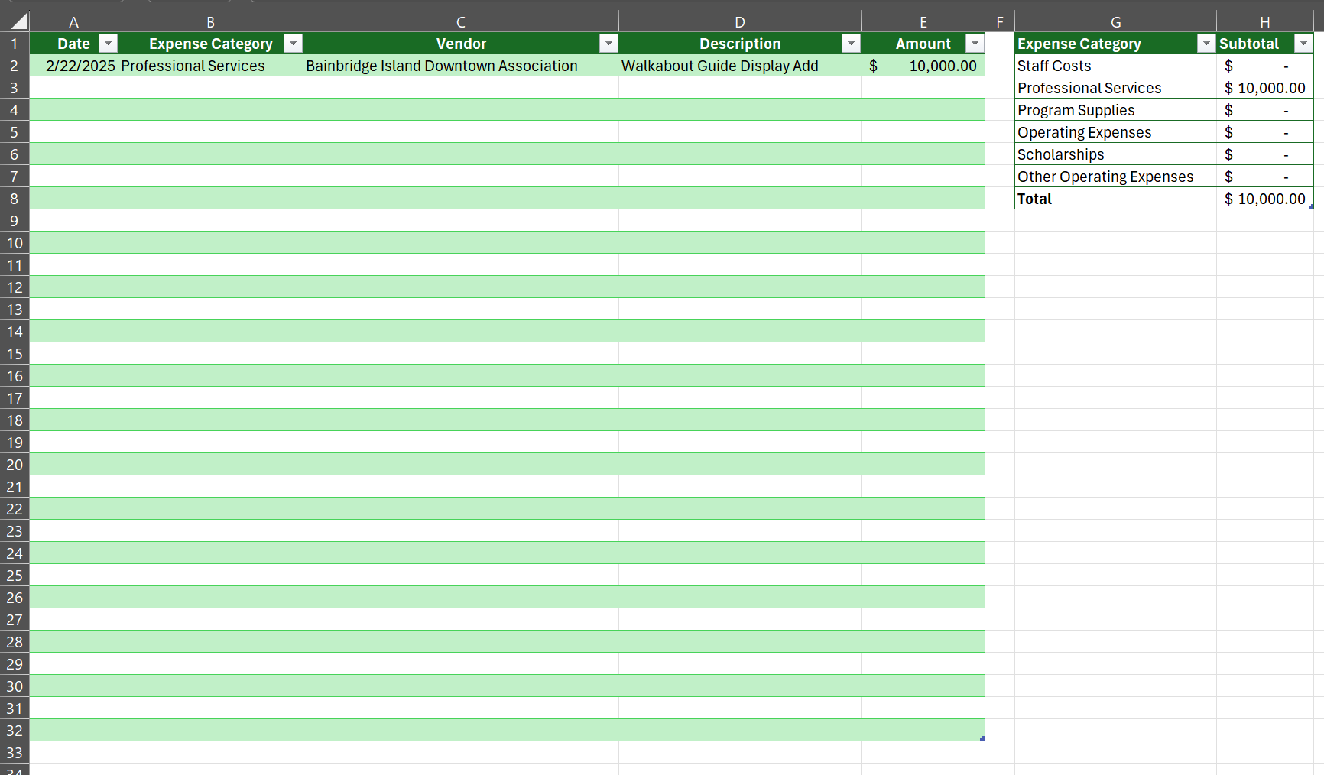
Expense Reimbursement
Jan. 23, 2025
Expense Reimbursement and Progress Reporting

Slide 5
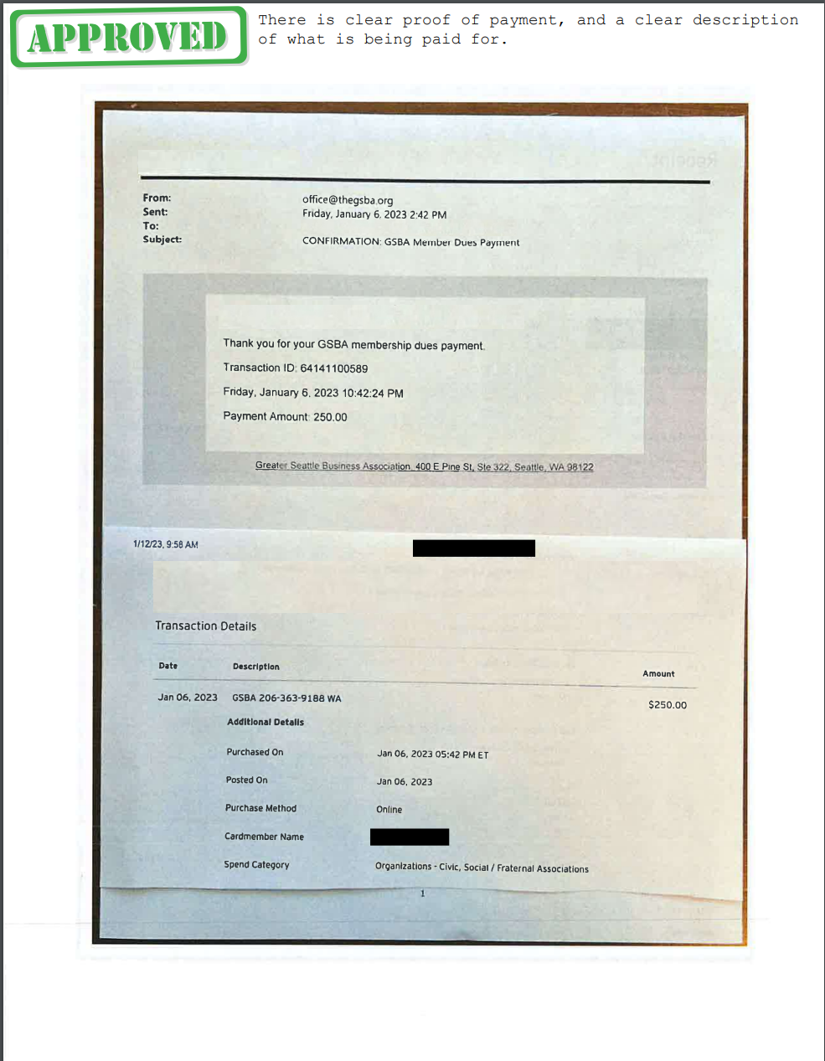
Expense Reimbursement
Page Title
Jan. 23, 2025
Expense Reimbursement and Progress Reporting

Slide 6
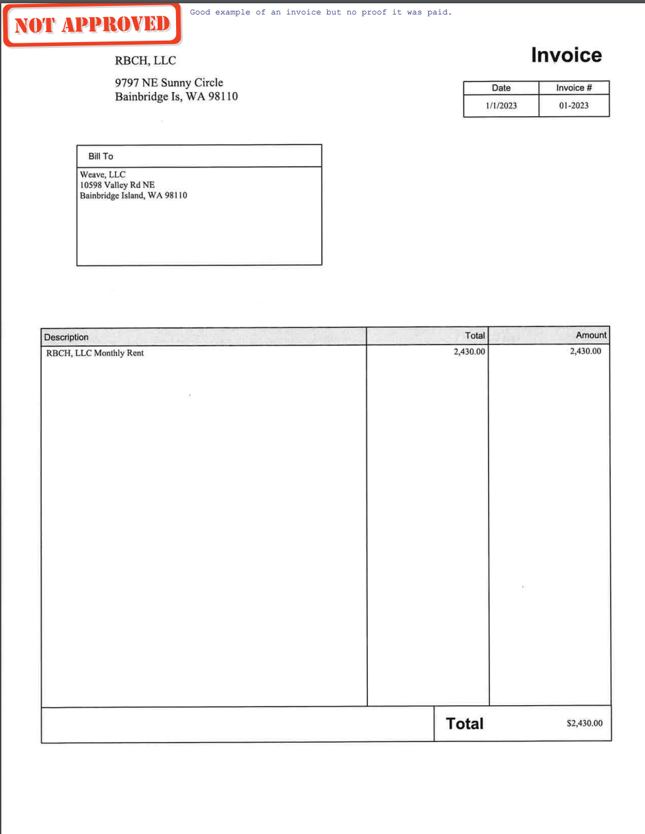
Expense Reimbursement
Page Title
Jan. 23, 2025
Expense Reimbursement and Progress Reporting

Slide 7
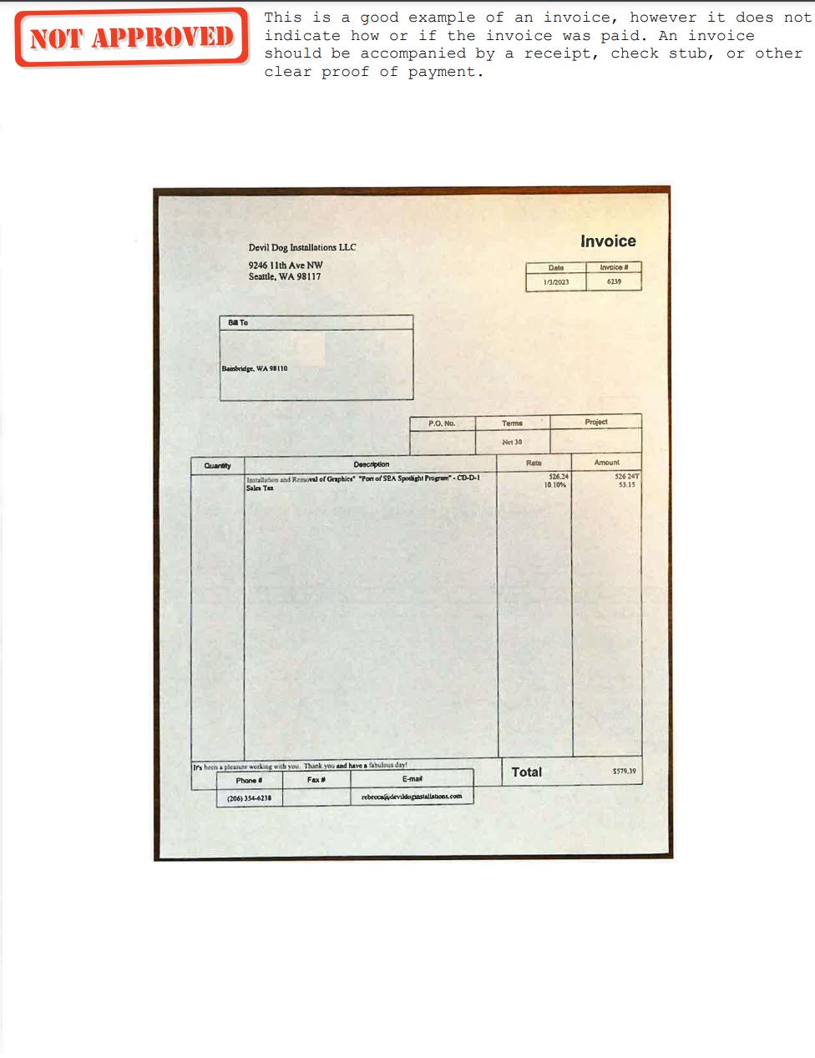
Expense Reimbursement
Page Title
Jan. 23, 2025
Expense Reimbursement and Progress Reporting

Slide 8
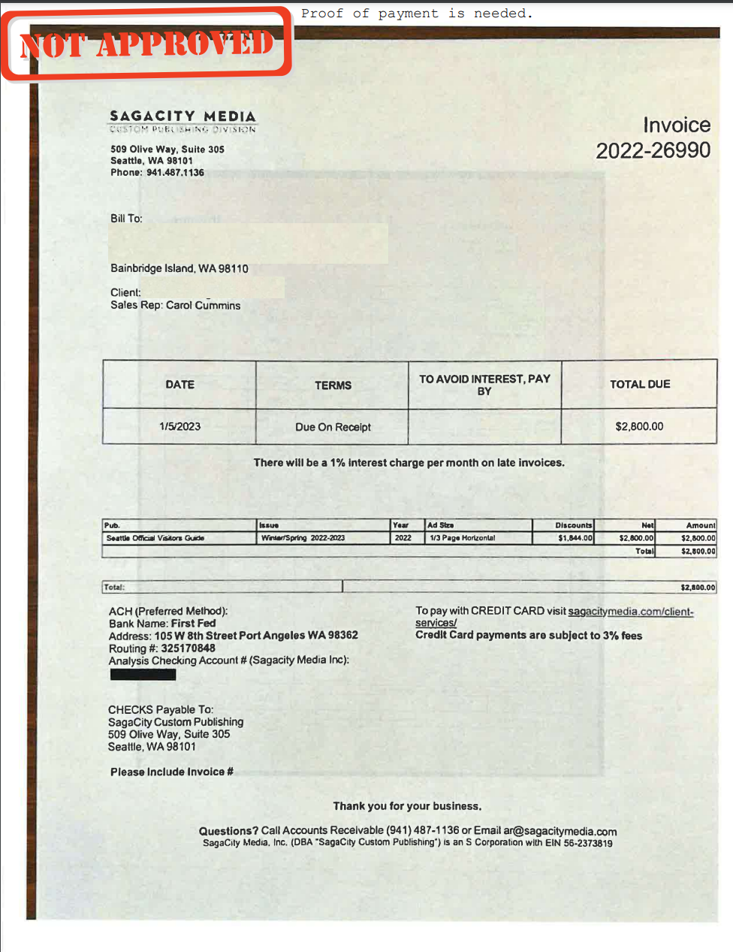
Expense Reimbursement
Page Title
Jan. 23, 2025
Expense Reimbursement and Progress Reporting

Slide 9
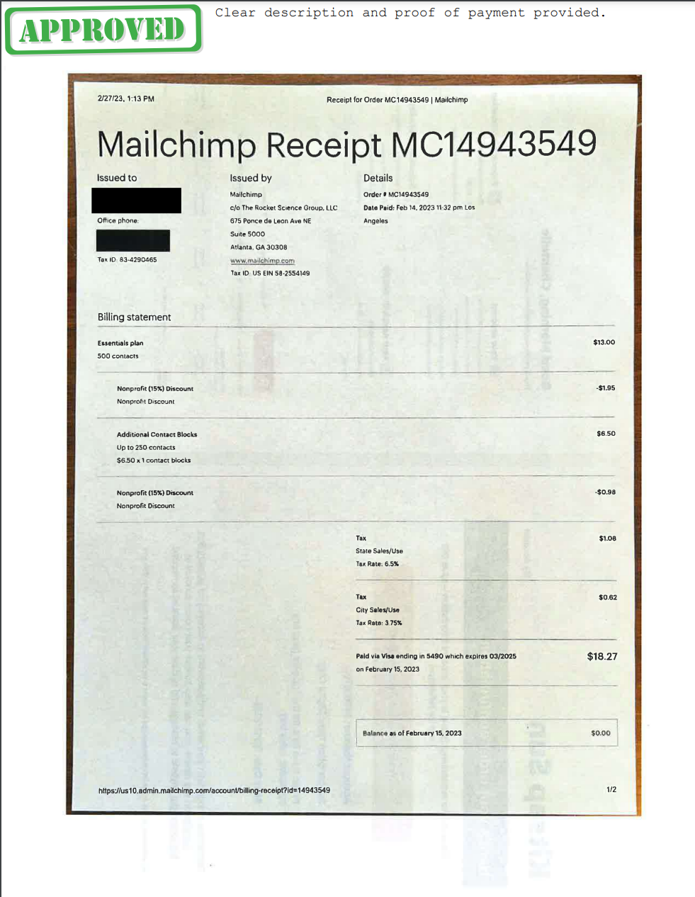
Expense Reimbursement
Page Title
Jan. 23, 2025
Expense Reimbursement and Progress Reporting

Slide 10
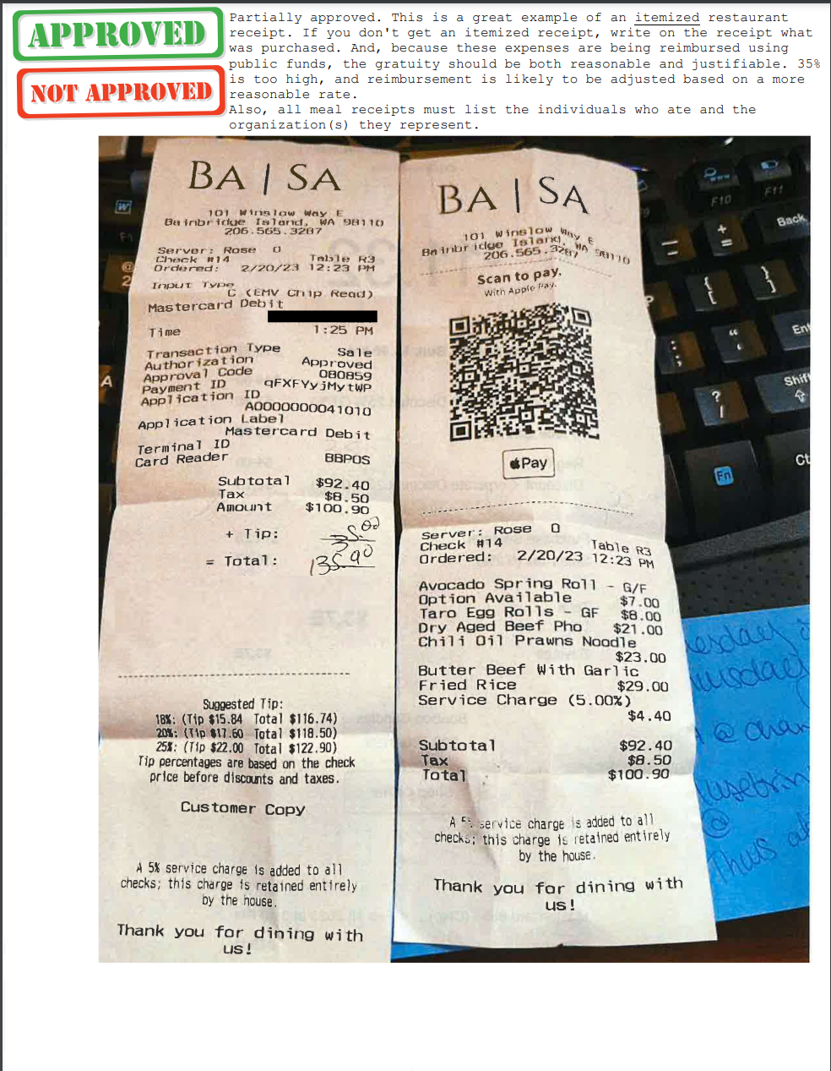
Expense Reimbursement
Page Title
Jan. 23, 2025
Expense Reimbursement and Progress Reporting

Slide 11
Expense Reimbursement
What can I invoice and when?
Jan. 23, 2025
Each Month: If you wish to submit monthly invoices, total the amount under the “Quarter” column that the month falls under. For example, if you submit a reimbursement request for staff costs for the month of April, put that total in Q2 and specify it is for the month of April in “Additional Comments” at the bottom. The following expenses may be submitted monthly:
Staff Costs
Other Operating Expenses: Rent
Expense Reimbursement and Progress Reporting

Slide 12
Expense Reimbursement
What can I invoice and when? (Cont’d)
Jan. 23, 2025
Each Quarter: Please submit the expenses representative of each category in the quarter and total them in the representative quarter. The following expenses are to be submitted quarterly:
Professional Services/Consultants/Contractors
Program Supplies
Scholarships
Other: Promotions/Marketing, Insurance, etc.
All other expenses not labeled in monthly
Expense Reimbursement and Progress Reporting

Slide 13
Expense Reimbursement
What can I invoice and when? (Cont’d)
Jan. 23, 2025
The following expenses will not be reimbursed:
Gift cards/Cash/Other tangible gifts
Alcohol
Gratuity tips beyond 20%
Unsupported or duplicate expenses
Expenses not related to the grant agreement
Personal expenses of staff, vendors, board members or volunteers
Legal expenses (unless specifically allowed by the contract)
*The City reserves the right to not reimburse for expenses if they do not align with City Expense Policies.
Expense Reimbursement and Progress Reporting

Slide 14
Progress Reporting
Expense Reimbursement and Progress Reporting

Slide 15
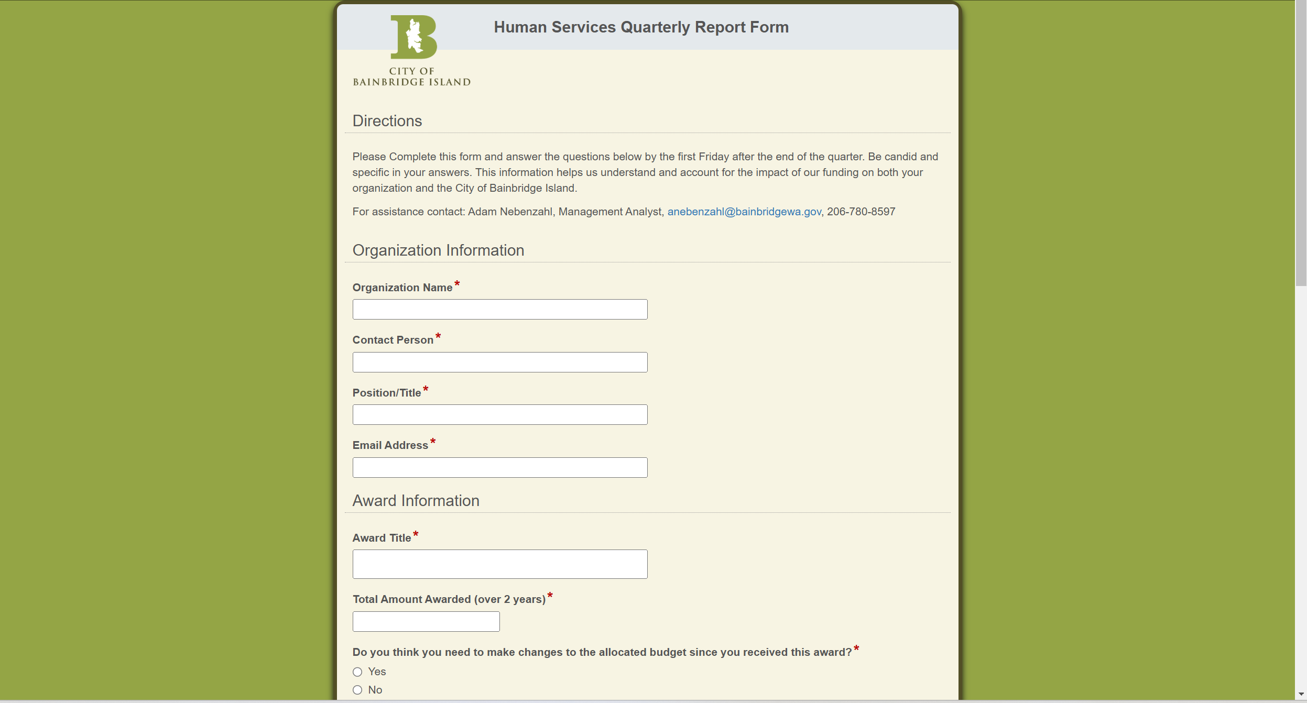
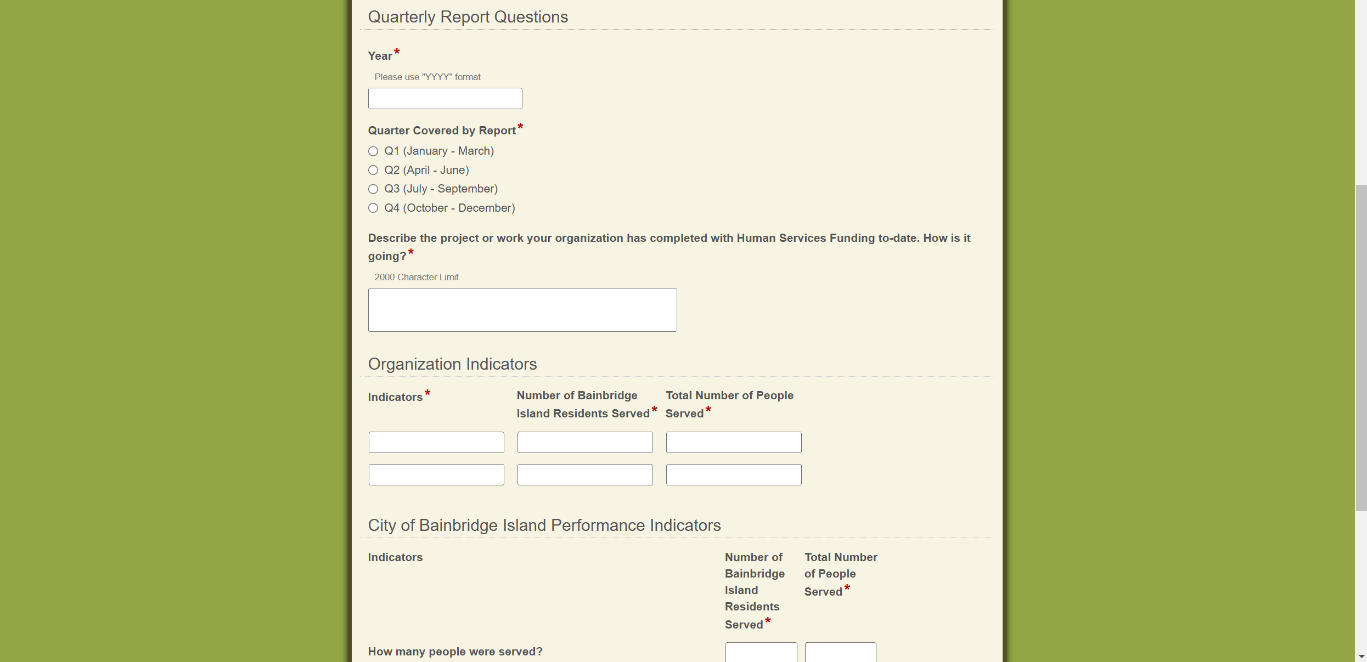
Progress Reporting
Jan. 23, 2025
Expense Reimbursement and Progress Reporting
Name of Presentation

Slide 16
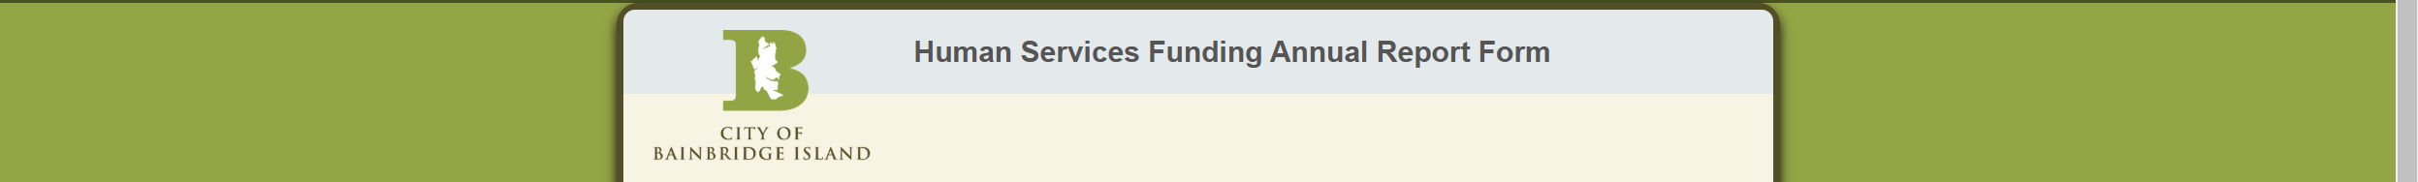
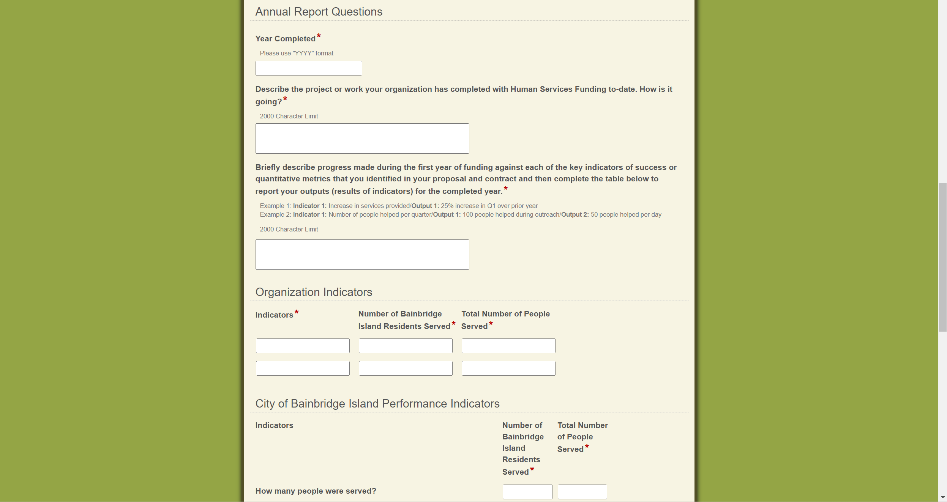
Progress Reporting
Jan. 23, 2025
Expense Reimbursement and Progress Reporting
Name of Presentation

Slide 17
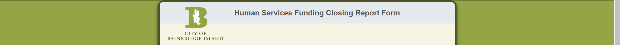
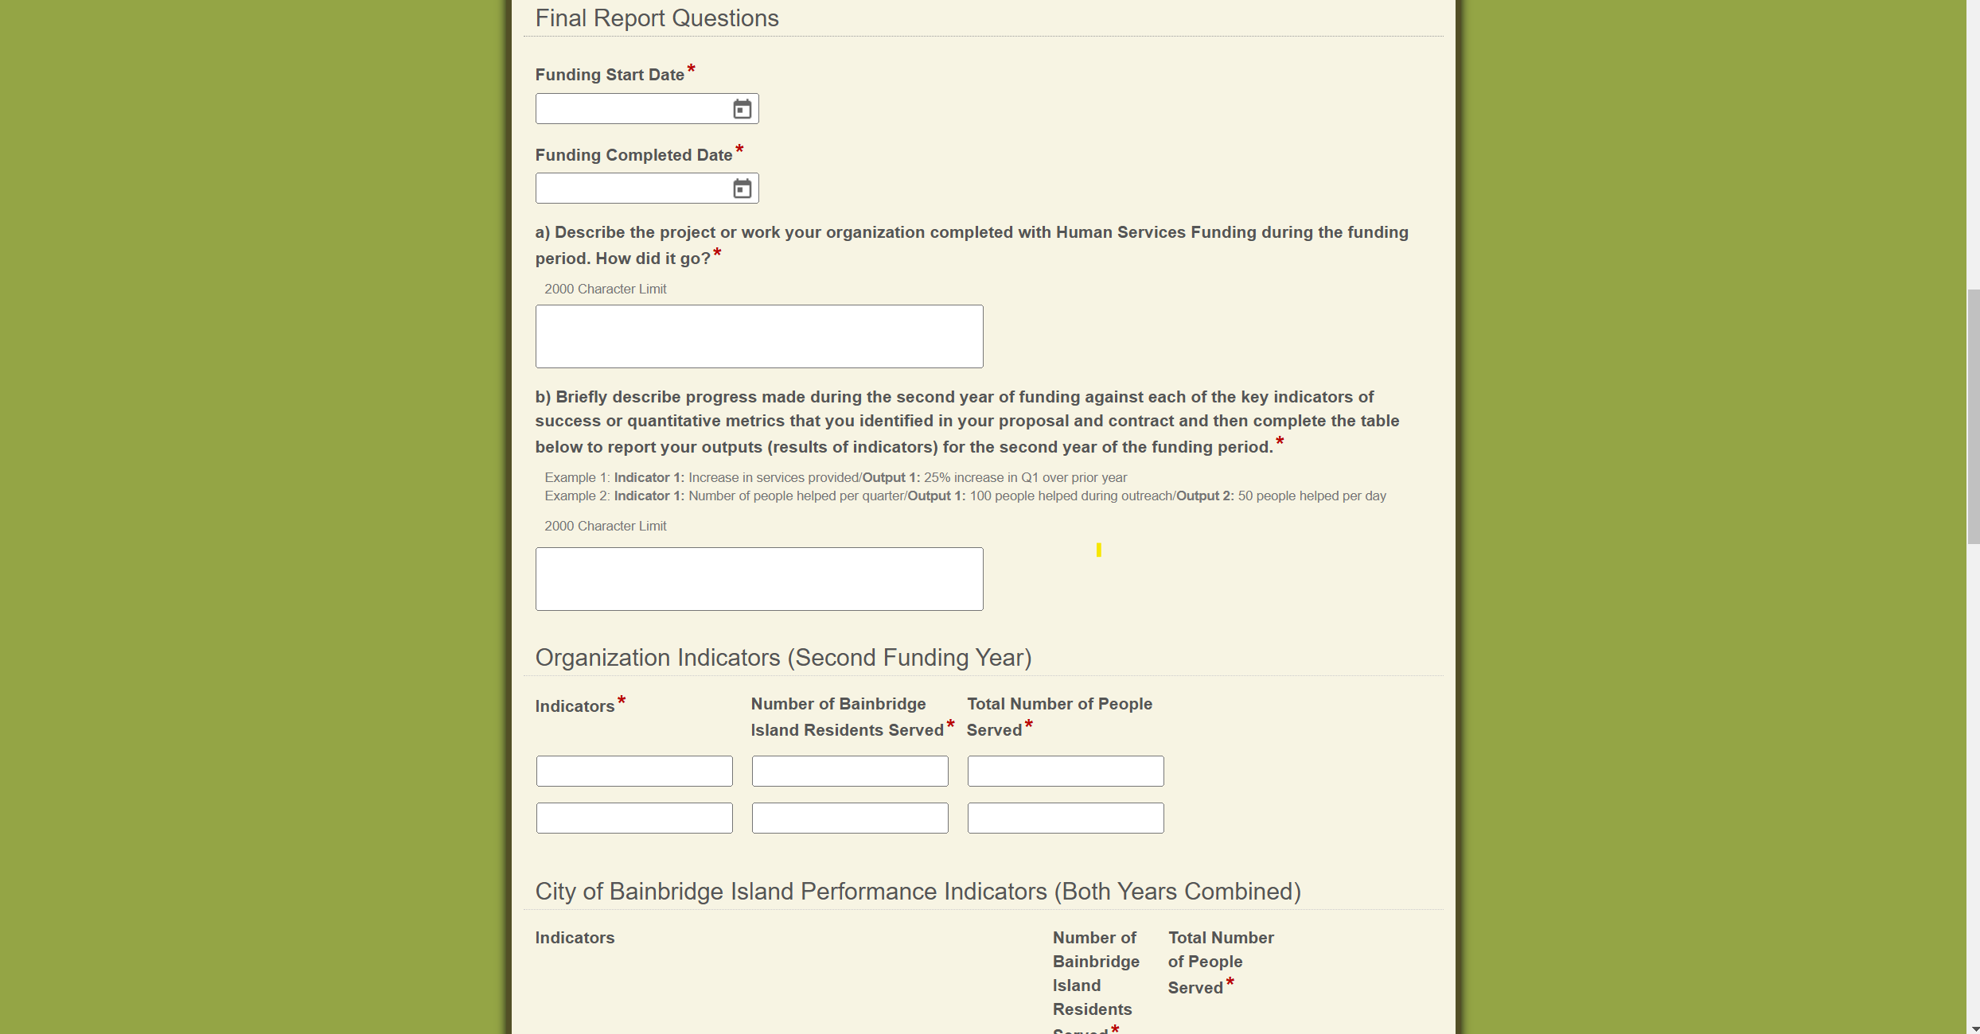
Progress Reporting
Jan. 23, 2025
Expense Reimbursement and Progress Reporting
Name of Presentation

Slide 18
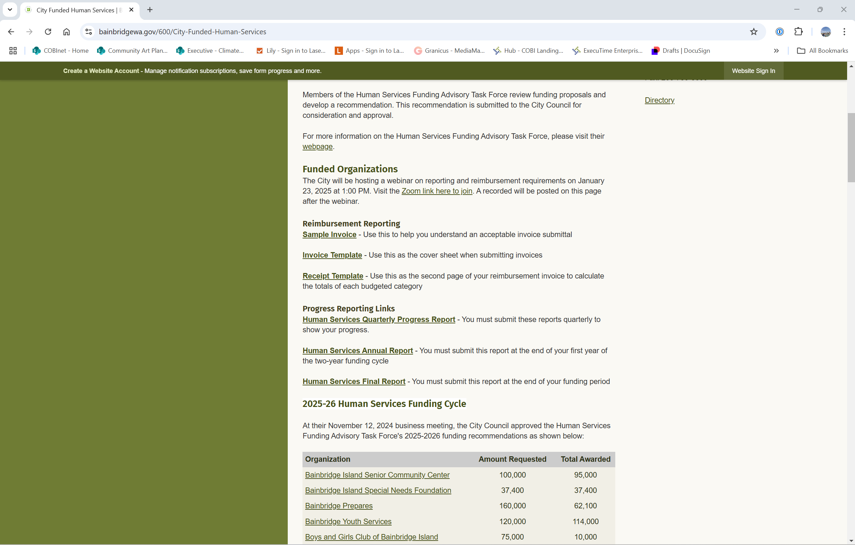
Progress Reporting
Jan. 23, 2025
Expense Reimbursement and Progress Reporting
Name of Presentation

Slide 19
Questions?
Expense Reimbursement and Progress Reporting

Slide 20
Thank you
Submitted by:
Adam Nebenzahl
Executive Department
anebenzahl@bainbridgewa.gov

